Slide 1
Quercus Quickstart - Before we get started
Before we get started
Let us know if you can hear us when we do Audio checks
Turn on live captions if you would like closed captioning
Quercus
Quickstart
Following the webinar
View Session Recording
at uoft.me/ctsi-videos
in 2 business days
During the webinar
Your microphone
will be muted until Q&A at the end of the session
Complete Feedback Survey (link sent via email)
Type questions and comments into the Chat
Download Presentation Slides at uoft.me/ctsi-videos
Notes:
Leave this slide up as participants enter to provide key information about the MS Teams platform – show site with videos and mention that other session recordings and resources are also there
You can also hide the chat panel if you find the incoming chat posts distracting
Highlight option to “Turn on live captions”

Slide 2
Quercus Quickstart
Derek Hunt, Marko Piljevic, Maryam Shafiei
August 2023
Notes:
*Begin recording*
Will share slides after along with additional resources
Introduce presenters / video on
Colleagues will be monitoring the chat and answering your questions

Slide 3
Agenda: 10am-11am, Overview of Quercus for instructors 11:00-11:10, Break 11:10-11:30, Importing a course template, creating a homepage 11:30-noon, Questions and sharing of instructor use cases

Slide 4
Overview of Quercus for instructors
- Accessing Quercus & Your Courses - Overview & Navigation - Course Customization - Announcements & Communication - Adding Course Content - Assignments & Grading - Quercus Logistics & Course Lifecycle

Slide 5
What is Quercus?
teaching.utoronto.ca/educational-technology/

Slide 6
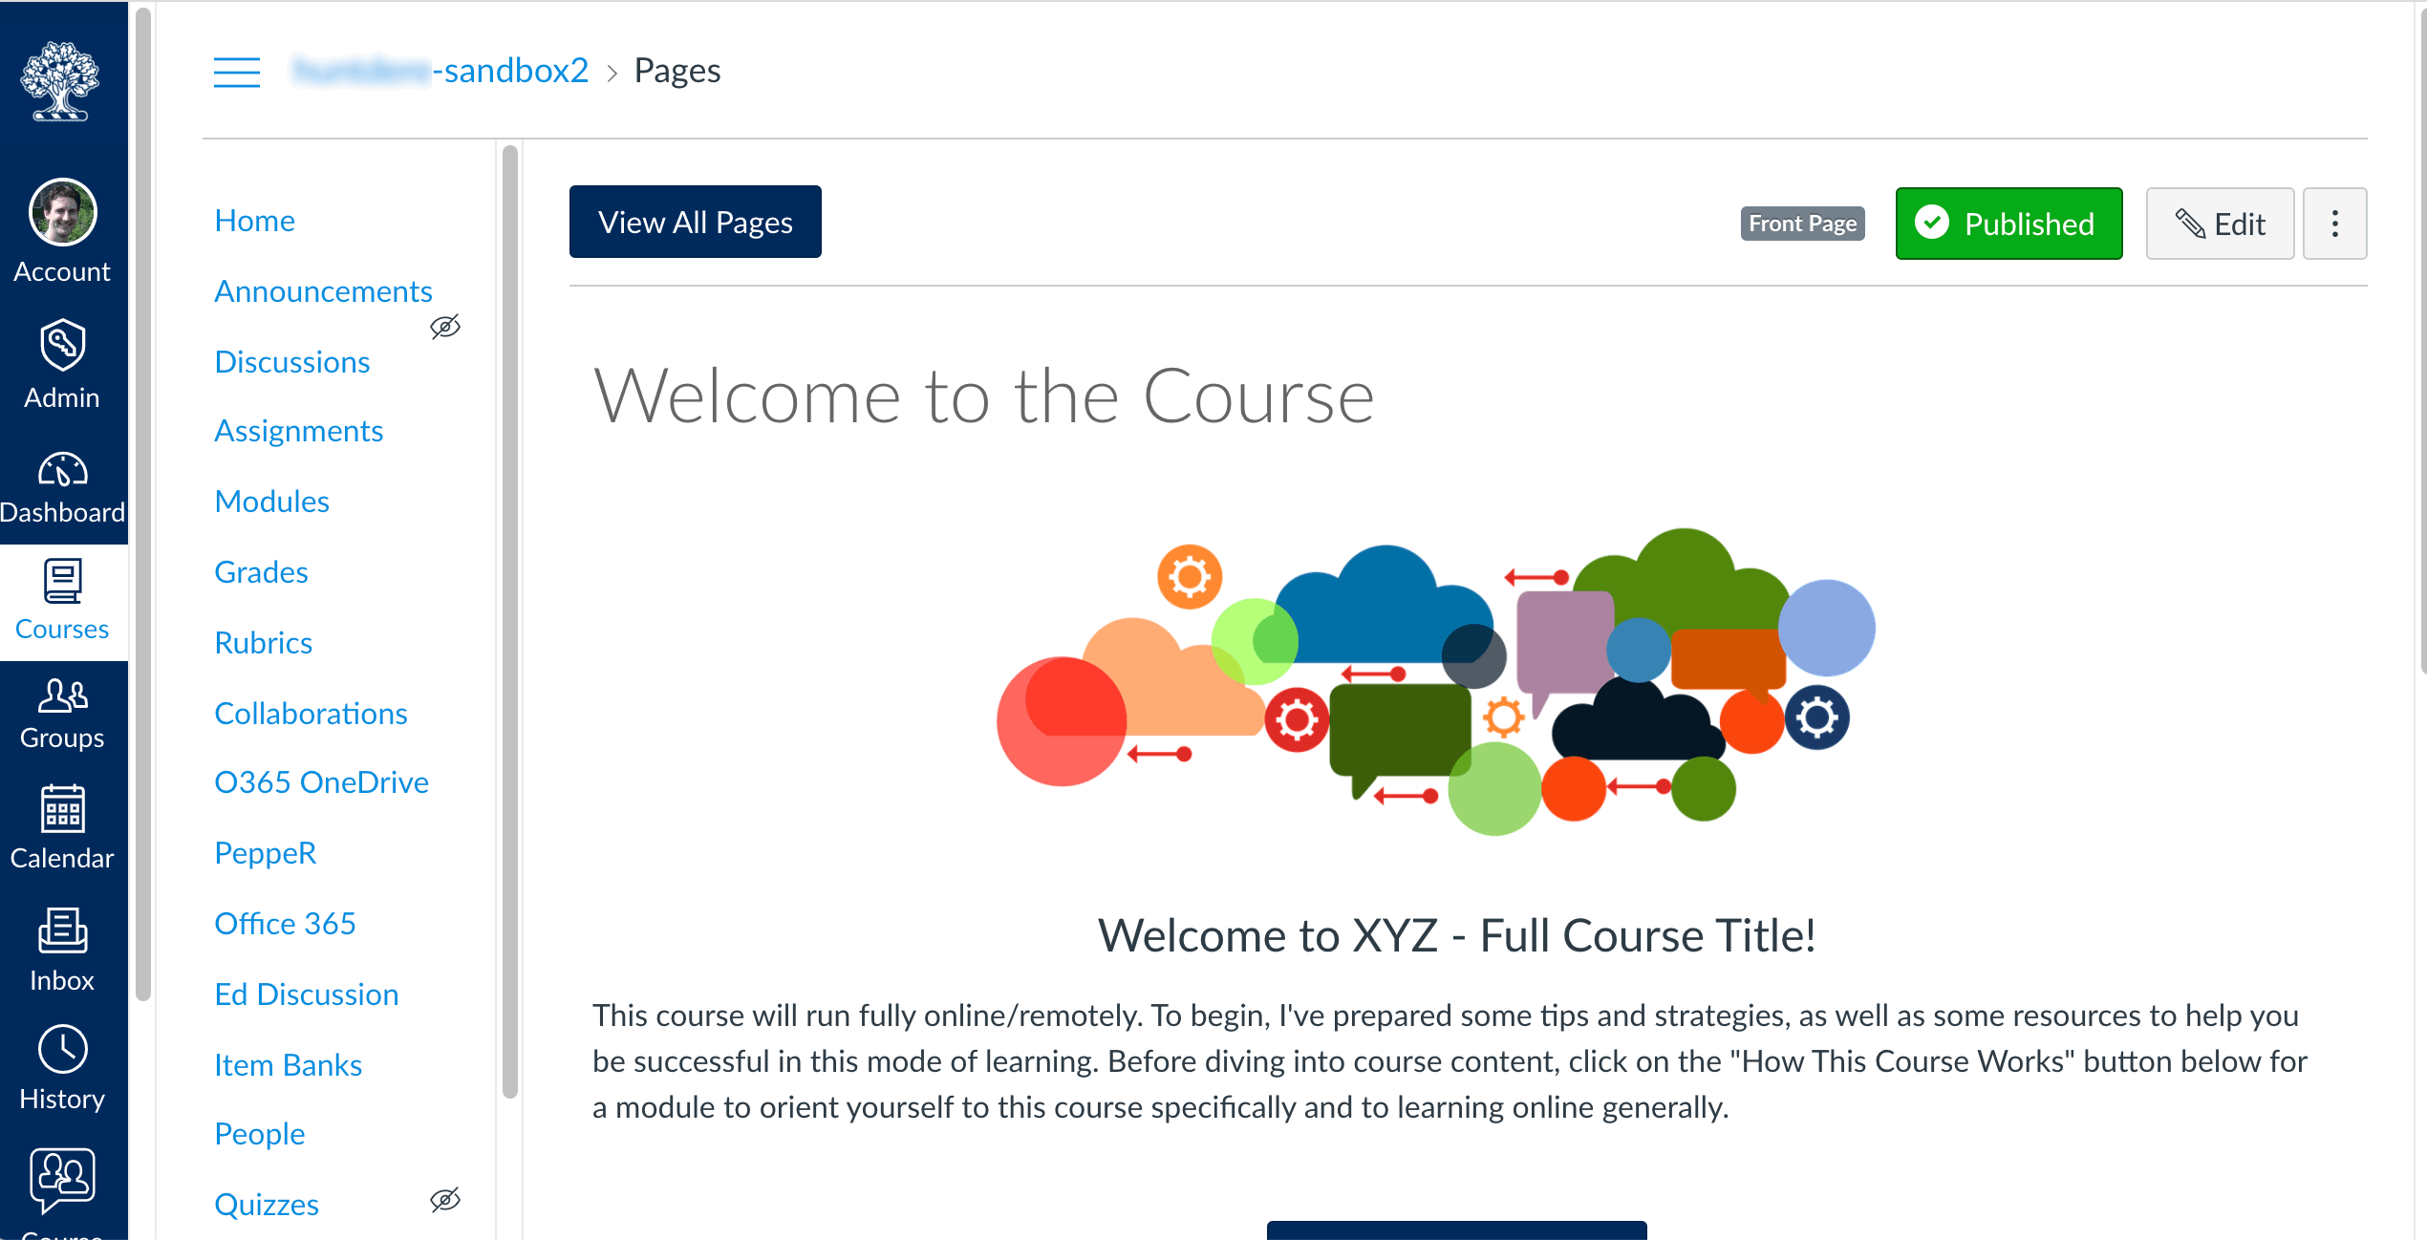
Let’s take a tour of a Quercus course

Slide 7
Break time!

Slide 8
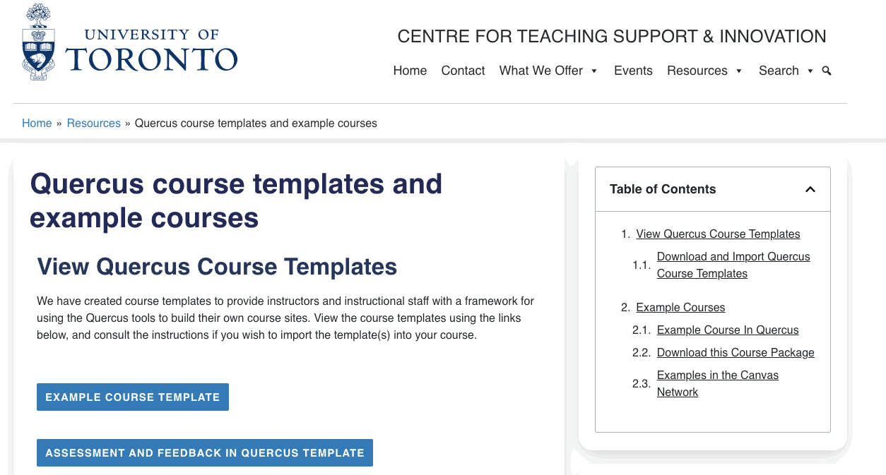
Import a course template
https://teaching.utoronto.ca/resources/quercus-course-templates-and-example-courses/

Slide 9
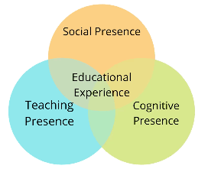
Building a Welcoming Home Page in Quercus
New Asynchronous Program: Building a Welcoming Home Page in Quercus
Social Presence
The Home Page lets students know that they are part of a community of learners.
The Home Page provides access to an online location for discussions/ questions.
Teaching Presence
The Home Page introduces students to the teaching team.
The Home provides information about how the course functions.
Cognitive Presence
The Home Page draws attention to key course learning goals/outcomes.
The Home Page includes a visual that represents the subject matter.
Accessibility
Accessibility The Home Page passed the Accessibility Checker.
Materials on the Home Page (e.g., videos, linked content) are accessible.
Register at: uoft.me/q-homepage
Notes:
Community of Inquiry model

Slide 10
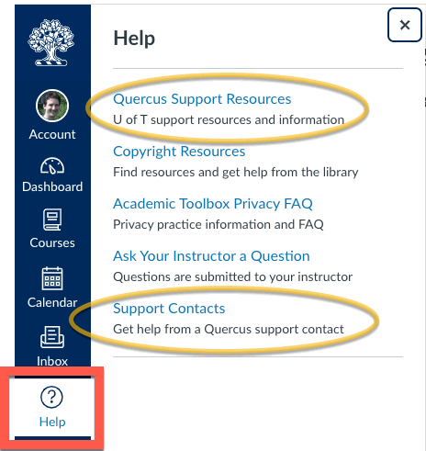
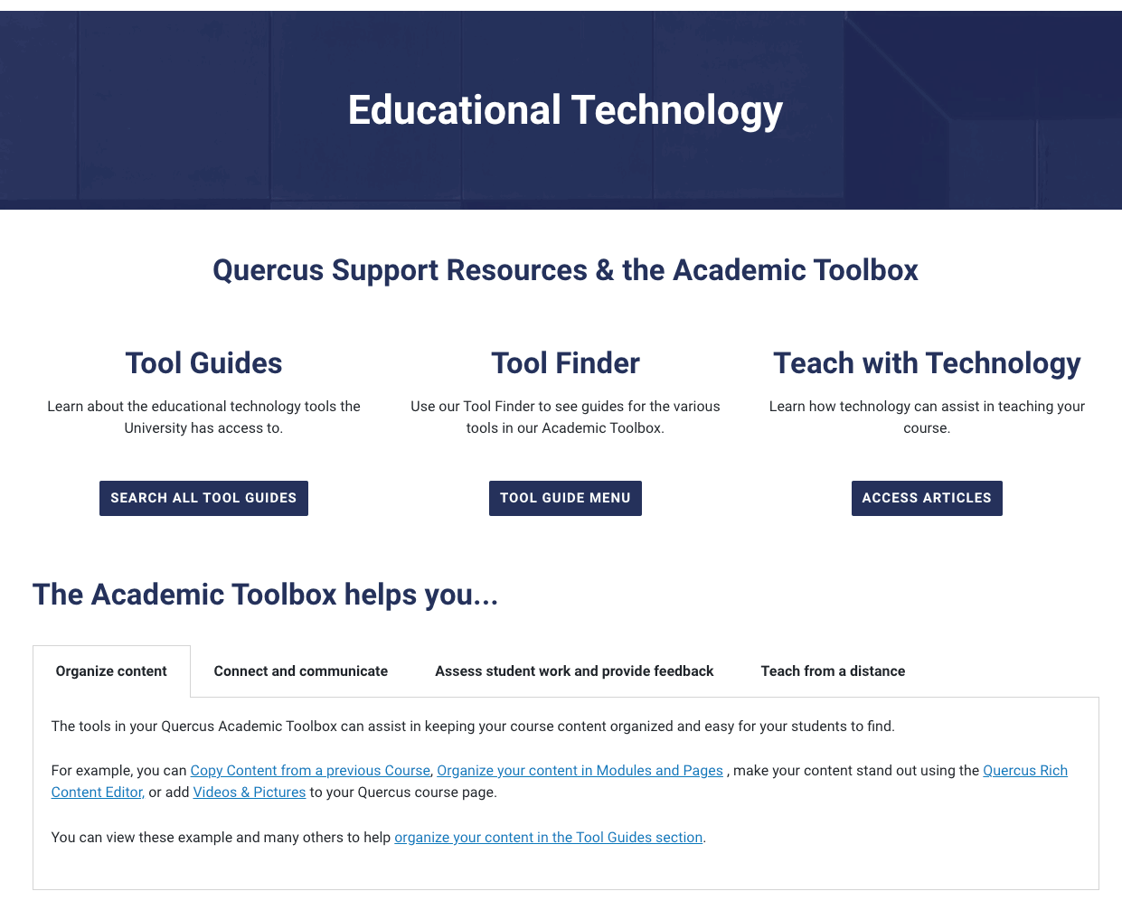
Quercus support resources
UofT.me/qresources

Slide 11
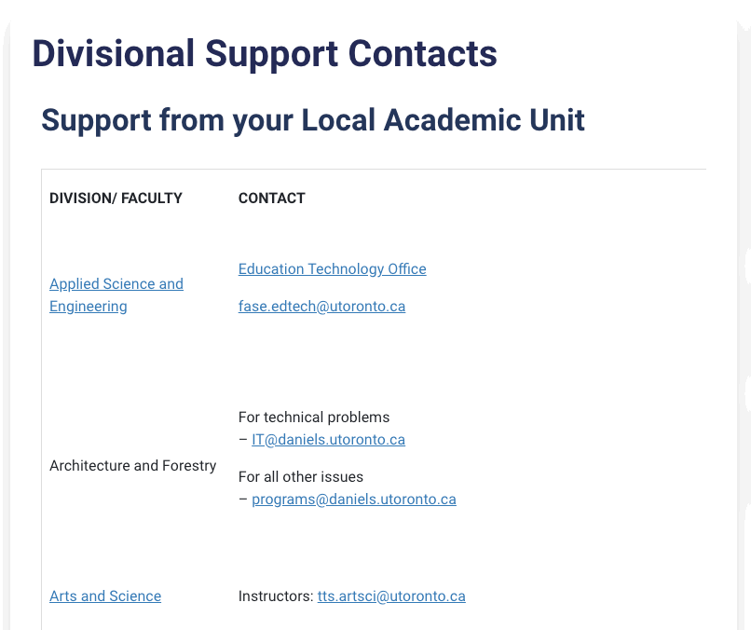
Where to get assistance - Divisional support
uoft.me/qsupportcontacts

Slide 12
Webinar Recordings and Events
Online/remote teaching webinars
Recordings and materials: uoft.me/ctsi-videos Upcoming CTSI events: teaching.utoronto.ca/events
Notes:
Today’s webinar just skimmed the surface of the possibilities for your upcoming course
We will be hosting webinars in the coming weeks, please check the latest schedule on the CTSI website

Slide 13
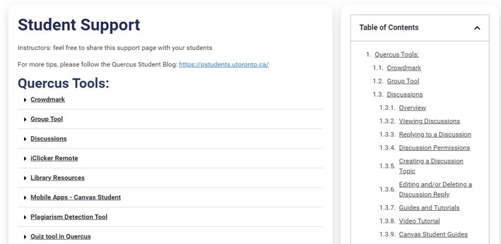
Student support resources
UofT.me/q-student
Notes:
What Technology Requirements Does U of T Recommend?
The University of Toronto has identified minimum technical requirements needed for students to access remote/online learning

Slide 14
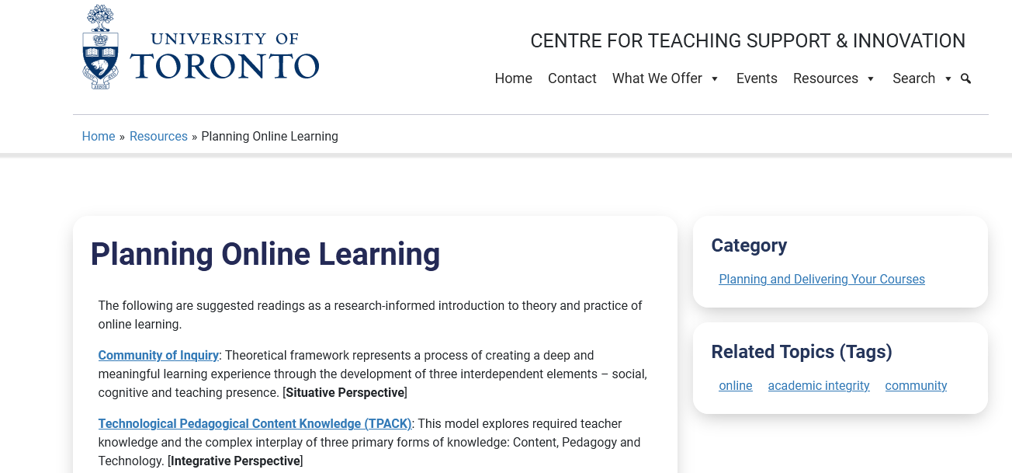
Planning guide: Online Learning
teaching.utoronto.ca/resources/planning-online-learning/
Notes:
Please check CTSI site for info re. Teaching online/remotely- Planning for next term
These pages are continuously being updated with new information, we encourage you to bookmark it and check regularly for updates
CTSI main website: teaching.utoronto.ca

Slide 15
Once your Quercus course is done – have a Quercus course review
teaching.utoronto.ca/teaching-feedback-services/quercus-course-reviews/

Slide 16
Questions? Thank you!
CTSI website: teaching.utoronto.ca Upcoming events: teaching.utoronto.ca/events Quercus Support Resources: uoft.me/qresources Divisional Support: uoft.me/qsupportcontacts CTSI webinar recordings: uoft.me/ctsi-videos Questions: q.help@utoronto.ca

